Slide 1





Loyalist College 1st Term 2024
This presentation was not made by AI
FRAUD DETECTION
Made By Humans powered by AI
Presented by:
Present for:
Group B
AISC Term 1

Slide 2

Agenda
03 | Timeline and Stakeholders
04 | Why prevent fraud is important
05 | Chosen model
06 | Flow of data
07 | Dashboard
08 | Kudos and questions

Slide 3


Linha do tempo
Discutir brevemente as datas-chave para o projeto.
2º Month
Now we also have to deal with statistics?? Oh my god!!
3º Month
1º Month
What is this dark magic, how is my model predicting fraud??
How do we work with data???!! This is so hard!!
4º Month
Okay it was not dark magic we were overreacting :)

Slide 4

Stakeholders
Who are them? Where they live? What they do?

Slide 5
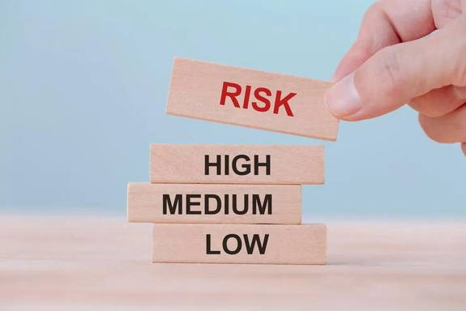
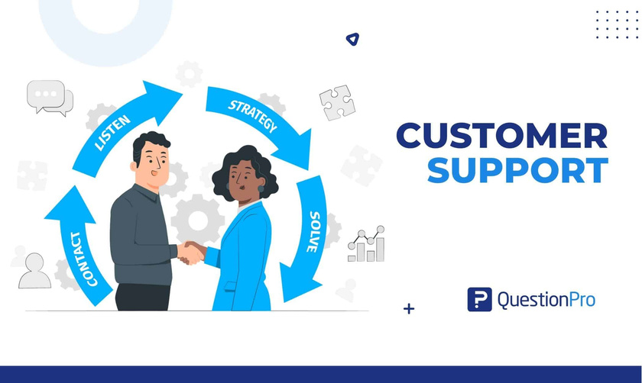


Stakeholders
Who are them? Where they live? What they do?
Fraud Detection
Risk Management
They will detect anomalies in users behavior
Customer Service
They will take care of risk assessment and mitigation
They will be the ones to say why the user is or is not getting the loan.

Slide 6
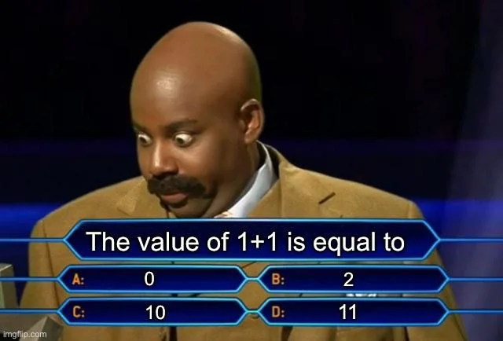
The question of millions
An OK Logistic regression VS an extremely good XGBoost?

Slide 7

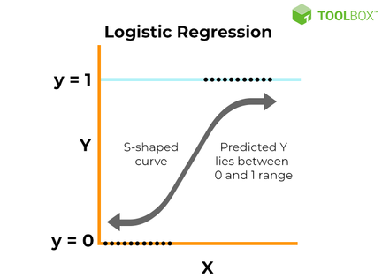
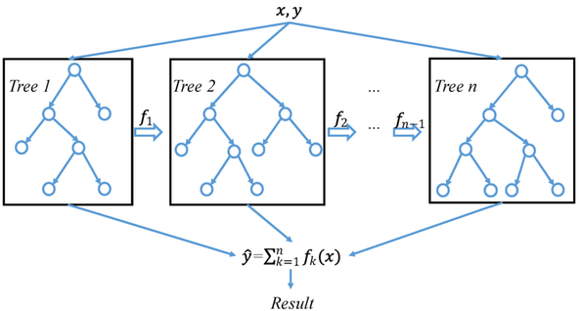
Let's see who was right!!
If you picked Logistic Regression
If you picked XGBoost
You are right!!!!
You are wrong, but only in our context.

Slide 8
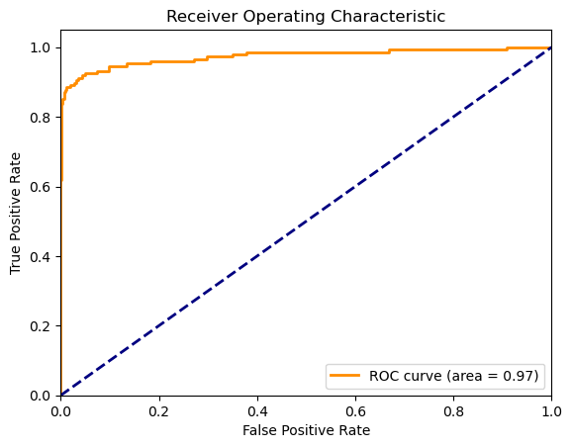
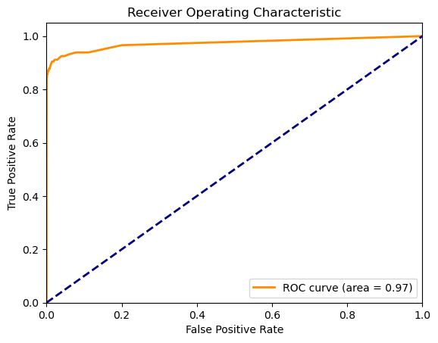
Winner Model
Drastic Effort
Logistic Regression
Effortless XGBoost

Slide 9
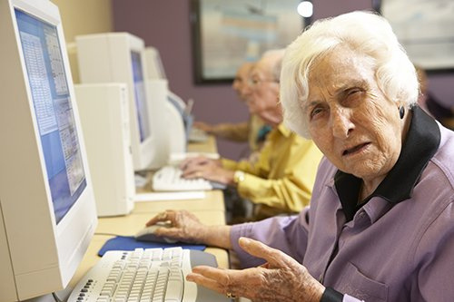
Sir, are you lying to me?
It says here you have a negative cash balance!!

Slide 10

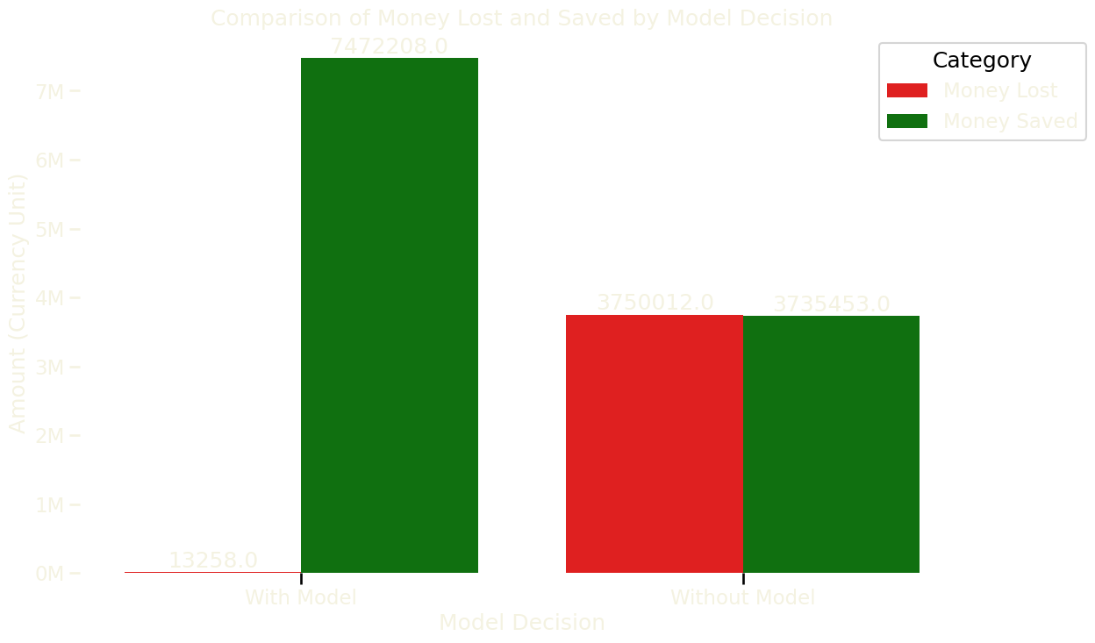
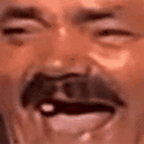
Why prevent Fraud is so important for a bank?
Almost 4M without model
Imagine a bank would go bankrupt!!

Slide 11

Let's wrap it all up!!

Slide 12
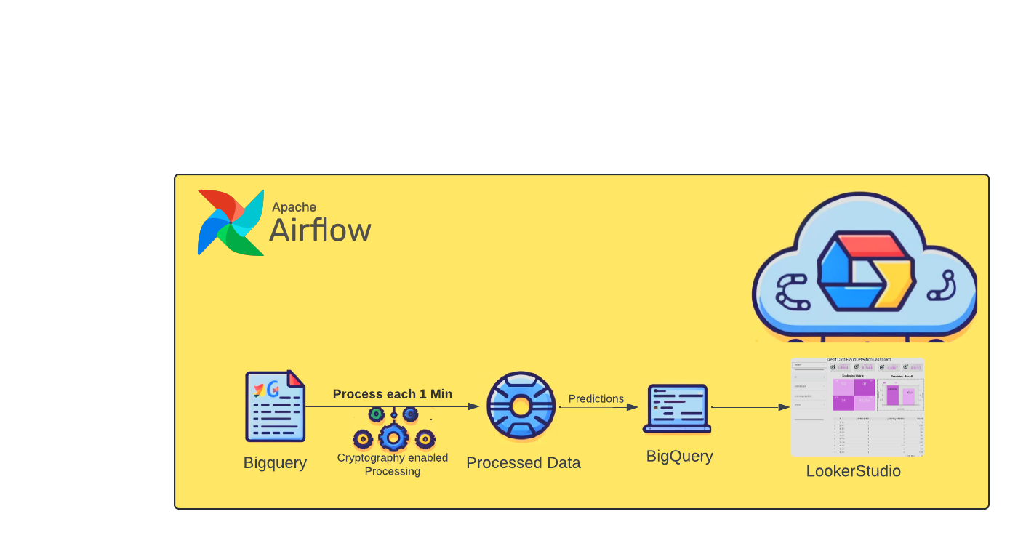
Flow of data

Slide 13
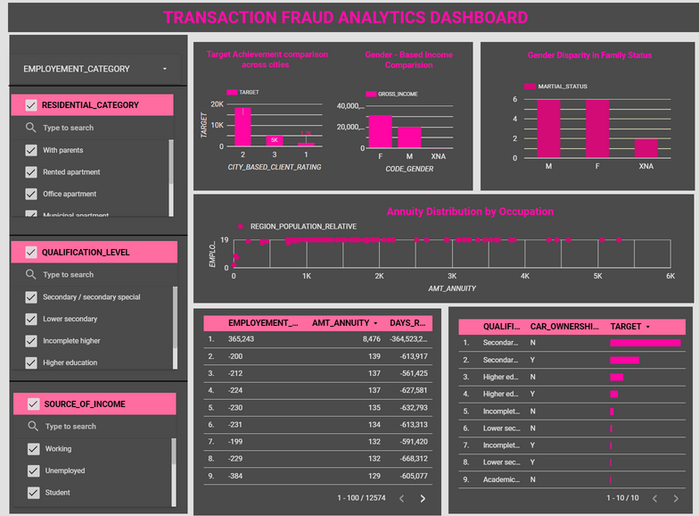
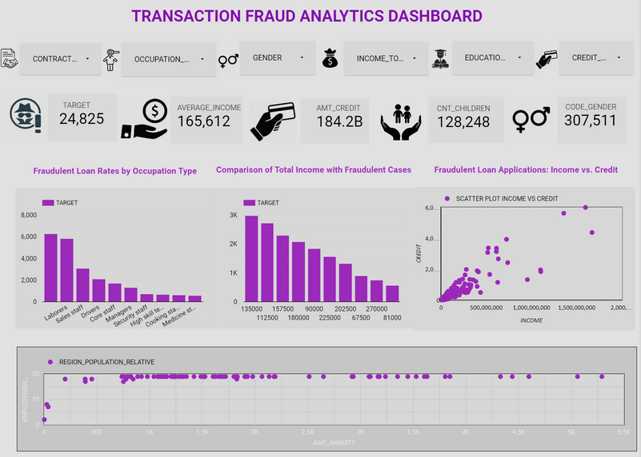
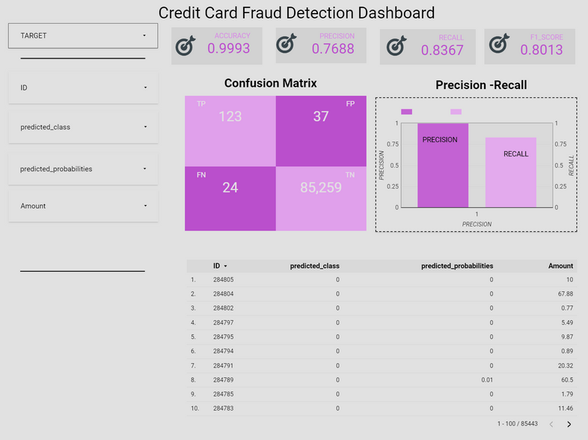
Dashboard
Before
After

Slide 14

Special Thanks and Questions!

